Slide 1
SQL
SQL is a database computer language designed for the retrieval and management of data in a relational database. SQL stands for Structured Query Language.
SQL is a language to operate databases; it includes database creation, deletion, fetching rows, modifying rows, etc. SQL is an ANSI (American National Standards Institute) standard language, but there are many different versions of the SQL language.

Slide 2
What is SQL?
SQL is Structured Query Language, which is a computer language for storing, manipulating and retrieving data stored in a relational database.
SQL is the standard language for Relational Database System. All the Relational Database Management Systems (RDMS) like MySQL, MS Access, Oracle, Sybase, Informix, Postgres and SQL Server use SQL as their standard database language.
Also, they are using different dialects, such as −
MS SQL Server using T-SQL,
Oracle using PL/SQL,
MS Access version of SQL is called JET SQL (native format) etc.

Slide 3
Why SQL?
SQL is widely popular because it offers the following advantages −
Allows users to access data in the relational database management systems.
Allows users to describe the data.
Allows users to define the data in a database and manipulate that data.
Allows to embed within other languages using SQL modules, libraries & pre-compilers.
Allows users to create and drop databases and tables.
Allows users to create view, stored procedure, functions in a database.
Allows users to set permissions on tables, procedures and views.

Slide 4
A Brief History of SQL
1970 − Dr. Edgar F. "Ted" Codd of IBM is known as the father of relational databases. He described a relational model for databases.
1974 − Structured Query Language appeared.
1978 − IBM worked to develop Codd's ideas and released a product named System/R.
1986 − IBM developed the first prototype of relational database and standardized by ANSI. The first relational database was released by Relational Software which later came to be known as Oracle.

Slide 5
SQL Process
When you are executing an SQL command for any RDBMS, the system determines the best way to carry out your request and SQL engine figures out how to interpret the task.
There are various components included in this process.
These components are −
Query Dispatcher
Optimization Engines
Classic Query Engine
SQL Query Engine, etc.
A classic query engine handles all the non-SQL queries, but a SQL query engine won't handle logical files.

Slide 6
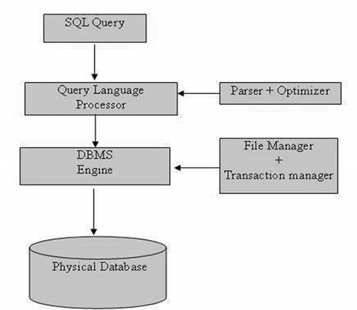
SQL Process
Following is a simple diagram showing the SQL Architecture

Slide 7
SQL Commands
The standard SQL commands to interact with relational databases are CREATE, SELECT, INSERT, UPDATE, DELETE and DROP. These commands can be classified into the following groups based on their nature
DDL - Data Definition Language
DML - Data Manipulation Language
DCL - Data Control Language

Slide 8
DDL - Data Definition Language
CREATE
Creates a new table, a view of a table, or other object in the database.
ALTER
Modifies an existing database object, such as a table.
DROP
Deletes an entire table, a view of a table or other objects in the database.

Slide 9
DML - Data Manipulation Language
SELECT
Retrieves certain records from one or more tables
INSERT
Creates a record.
UPDATE
Modifies records.
DELETE
Deletes records.

Slide 10
DCL - Data Control Language
GRANT
Gives a privilege to user.
REVOKE
Takes back privileges granted from user.

Slide 11
What is RDBMS?
RDBMS stands for Relational Database Management System. RDBMS is the basis for SQL, and for all modern database systems like MS SQL Server, IBM DB2, Oracle, MySQL, and Microsoft Access.
A Relational database management system (RDBMS) is a database management system (DBMS) that is based on the relational model as introduced by E. F. Codd.

Slide 12
What is a table?
The data in an RDBMS is stored in database objects which are called as tables. This table is basically a collection of related data entries and it consists of numerous columns and rows.
Remember, a table is the most common and simplest form of data storage in a relational database

Slide 13
Tables in SQL
Table name
Attribute names
Product
PName | Price | Category | Manufacturer
Gizmo | $19.99 | Gadgets | GizmoWorks
Powergizmo | $29.99 | Gadgets | GizmoWorks
SingleTouch | $149.99 | Photography | Canon
MultiTouch | $203.99 | Household | Hitachi
Tuples or rows

Slide 14
What is a NULL value?
A NULL value in a table is a value in a field that appears to be blank, which means a field with a NULL value is a field with no value.
It is very important to understand that a NULL value is different than a zero value or a field that contains spaces. A field with a NULL value is the one that has been left blank during a record creation.

Slide 15
SQL Constraints
Constraints are the rules enforced on data columns on a table. These are used to limit the type of data that can go into a table. This ensures the accuracy and reliability of the data in the database.
Constraints can either be column level or table level. Column level constraints are applied only to one column whereas, table level constraints are applied to the entire table.

Slide 16
SQL Constraints
Following are some of the most commonly used constraints available in SQL −
NOT NULL Constraint − Ensures that a column cannot have a NULL value.
DEFAULT Constraint − Provides a default value for a column when none is specified.
UNIQUE Constraint − Ensures that all the values in a column are different.
PRIMARY Key − Uniquely identifies each row/record in a database table.
FOREIGN Key − Uniquely identifies a row/record in any another database table.
CHECK Constraint − The CHECK constraint ensures that all values in a column satisfy certain conditions.

Slide 17
SQL - NOT NULL Constraint
By default, a column can hold NULL values. If you do not want a column to have a NULL value, then you need to define such a constraint on this column specifying that NULL is now not allowed for that column.
A NULL is not the same as no data, rather, it represents unknown data.

Slide 18
Example FOR NOT NULL
For example, the following SQL query creates a new table called PERSON
CREATE TABLE Persons (
ID int NOT NULL,
LastName varchar(255) NOT NULL,
FirstName varchar(255) NOT NULL,
Age int
);

Slide 19
SQL DEFAULT Constraint
The DEFAULT constraint is used to provide a default value for a column.
The default value will be added to all new records IF no other value is specified.
CREATE TABLE Persons (
ID int NOT NULL,
LastName varchar(255) NOT NULL,
FirstName varchar(255),
Age int,
City varchar(255) DEFAULT 'Sandnes'
);

Slide 20
SQL UNIQUE Constraint
The UNIQUE constraint ensures that all values in a column are different.
Both the UNIQUE and PRIMARY KEY constraints provide a guarantee for uniqueness for a column or set of columns.
A PRIMARY KEY constraint automatically has a UNIQUE constraint.
However, you can have many UNIQUE constraints per table, but only one PRIMARY KEY constraint per table.

Slide 21
SQL UNIQUE Constraint on CREATE TABLE
CREATE TABLE Persons (
ID int NOT NULL UNIQUE,
LastName varchar(255) NOT NULL,
FirstName varchar(255),
Age int
);

Slide 22
SQL PRIMARY KEY Constraint
The PRIMARY KEY constraint uniquely identifies each record in a database table.
Primary keys must contain UNIQUE values, and cannot contain NULL values.
A table can have only one primary key, which may consist of single or multiple fields.

Slide 23
SQL PRIMARY KEY on CREATE TABLE
CREATE TABLE Persons (
ID int NOT NULL,
LastName varchar(255) NOT NULL,
FirstName varchar(255),
Age int,
PRIMARY KEY (ID)
);

Slide 24
SQL FOREIGN KEY Constraint
A FOREIGN KEY is a key used to link two tables together.
A FOREIGN KEY is a field (or collection of fields) in one table that refers to the PRIMARY KEY in another table.
The table containing the foreign key is called the child table, and the table containing the candidate key is called the referenced or parent table.

Slide 25
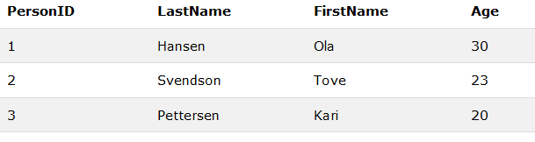
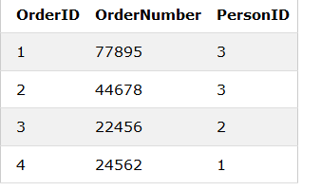
SQL FOREIGN KEY Constraint
CREATE TABLE Orders (
OrderID int NOT NULL,
OrderNumber int NOT NULL,
PersonID int,
PRIMARY KEY (OrderID),
FOREIGN KEY (PersonID) REFERENCES Persons(PersonID)
);

Slide 26
CREATE TABLE Orders (
OrderID int NOT NULL,
OrderNumber int NOT NULL,
PersonID int,
PRIMARY KEY (OrderID),
FOREIGN KEY (PersonID) REFERENCES Persons(PersonID)
);

Slide 27
SQL CHECK Constraint
The CHECK constraint is used to limit the value range that can be placed in a column.
If you define a CHECK constraint on a single column it allows only certain values for this column.
If you define a CHECK constraint on a table it can limit the values in certain columns based on values in other columns in the row.

Slide 28
SQL CHECK on CREATE TABLE
CREATE TABLE Persons (
ID int NOT NULL,
LastName varchar(255) NOT NULL,
FirstName varchar(255),
Age int,
CHECK (Age>=18)
);

Slide 29
Data Integrity
The following categories of data integrity exist with each RDBMS −
Entity Integrity − There are no duplicate rows in a table.
Domain Integrity − Enforces valid entries for a given column by restricting the type, the format, or the range of values.
Referential integrity − Rows cannot be deleted, which are used by other records.
User-Defined Integrity − Enforces some specific business rules that do not fall into entity, domain or referential integrity.

Slide 30
DDL - Data Definition Language
SQL CREATE TABLE Statement
CREATE TABLE Persons (
PersonID int,
LastName varchar(255),
FirstName varchar(255),
Address varchar(255),
City varchar(255)
);

Slide 31
DDL - Data Definition Language
SQL ALTER TABLE Statement
The ALTER TABLE statement is used to add, delete, or modify columns in an existing table.
The ALTER TABLE statement is also used to add and drop various constraints on an existing table.
ALTER TABLE table_name
MODIFY COLUMN column_name datatype;

Slide 32
SQL DROP TABLE Statement
The DROP TABLE statement is used to drop an existing table in a database.
Syntax
DROP TABLE table_name;

Slide 33
DML - Data Manipulation Language
SELECT
Retrieves certain records from one or more tables
INSERT
Creates a record.
UPDATE
Modifies records.
DELETE
Deletes records.

Slide 34
SELECT COMMAND
The SELECT statement is used to select data from a database.
The data returned is stored in a result table, called the result-set.
SELECT Syntax
SELECT column1, column2, ...
FROM table_name;

Slide 35
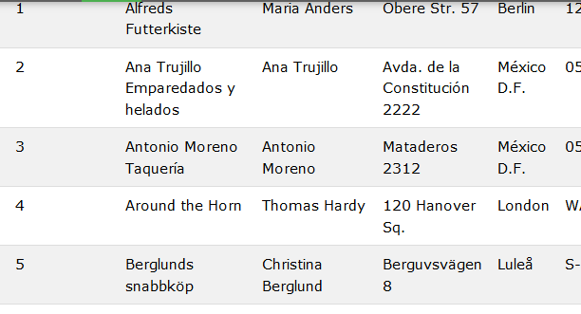
SELECT COMMAND
SELECT CustomerName, City FROM Customers;
SQL> SELECT * FROM CUSTOMERS;

Slide 36
SQL Query
Basic form: (plus many many more bells and whistles)
SELECT <attributes>
FROM <one or more relations>
WHERE <conditions>

Slide 37
Simple SQL Query
Product
PName | Price | Category | Manufacturer
Gizmo | $19.99 | Gadgets | GizmoWorks
Powergizmo | $29.99 | Gadgets | GizmoWorks
SingleTouch | $149.99 | Photography | Canon
MultiTouch | $203.99 | Household | Hitachi
SELECT *
FROM Product
WHERE category=‘Gadgets’
PName | Price | Category | Manufacturer
Gizmo | $19.99 | Gadgets | GizmoWorks
Powergizmo | $29.99 | Gadgets | GizmoWorks
“selection”

Slide 38
Simple SQL Query
Product
PName | Price | Category | Manufacturer
Gizmo | $19.99 | Gadgets | GizmoWorks
Powergizmo | $29.99 | Gadgets | GizmoWorks
SingleTouch | $149.99 | Photography | Canon
MultiTouch | $203.99 | Household | Hitachi
SELECT PName, Price, Manufacturer
FROM Product
WHERE Price > 100
PName | Price | Manufacturer
SingleTouch | $149.99 | Canon
MultiTouch | $203.99 | Hitachi
“selection” and
“projection”

Slide 39
Notation
Input Schema
Product(PName, Price, Category, Manfacturer)
SELECT PName, Price, Manufacturer
FROM Product
WHERE Price > 100
Answer(PName, Price, Manfacturer)
Output Schema

Slide 40
Details
Case insensitive:
  Same: SELECT Select select
  Same: Product product
  Different: ‘Seattle’ ‘seattle’
Constants:
  ‘abc’ - yes
  “abc” - no

Slide 41
Eliminating Duplicates
Category
Gadgets
Photography
Household
SELECT DISTINCT category
FROM Product
Compare to:
Category
Gadgets
Gadgets
Photography
Household
SELECT category
FROM Product

Slide 42
Ordering the Results
SELECT pname, price, manufacturer
FROM Product
WHERE category=‘gizmo’ AND price > 50
ORDER BY price, pname
Ties are broken by the second attribute on the ORDER BY list, etc.
Ordering is ascending, unless you specify the DESC keyword.

Slide 43
SQL - INSERT Query
The INSERT INTO statement is used to insert new records in a table.
INSERT INTO Syntax
It is possible to write the INSERT INTO statement in two ways.
The first way specifies both the column names and the values to be inserted:
INSERT INTO table_name (column1, column2, column3, ...)
VALUES (value1, value2, value3, ...); \or
INSERT INTO table_name
VALUES (value1, value2, value3, ...);

Slide 44
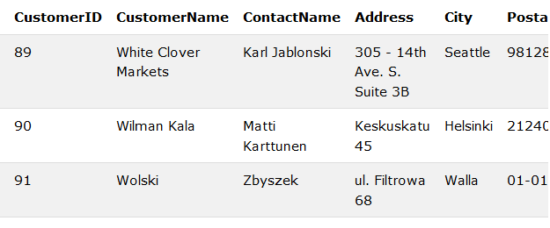
Example
INSERT INTO Customers (CustomerName, ContactName, Address, City, PostalCode, Country)
VALUES ('Cardinal', 'Tom B. Erichsen', 'Skagen 21', 'Stavanger', '4006', 'Norway');

Slide 45
SQL SELECT DISTINCT Statement
The SELECT DISTINCT statement is used to return only distinct (different) values.
Inside a table, a column often contains many duplicate values; and sometimes you only want to list the different (distinct) values.
The SELECT DISTINCT statement is used to return only distinct (different) values.
SELECT DISTINCT Syntax
SELECT DISTINCT column1, column2, ...
FROM table_name;

Slide 46
SQL SELECT DISTINCT Statement
SELECT Country FROM Customers;
SELECT DISTINCT Country FROM Customers;

Slide 47
SQL AND, OR and NOT Operators
The WHERE clause can be combined with AND, OR, and NOT operators.
The AND and OR operators are used to filter records based on more than one condition:
The AND operator displays a record if all the conditions separated by AND is TRUE.
The OR operator displays a record if any of the conditions separated by OR is TRUE.
The NOT operator displays a record if the condition(s) is NOT TRUE.

Slide 48
SQL AND, OR and NOT Operators
SELECT * FROM Customers
WHERE Country='Germany' AND City='Berlin'
SELECT * FROM Customers
WHERE City='Berlin' OR City='München';

Slide 49
SQL ORDER BY Keyword
The ORDER BY keyword is used to sort the result-set in ascending or descending order.
The ORDER BY keyword sorts the records in ascending order by default. To sort the records in descending order, use the DESC keyword.

Slide 50
SELECT * FROM Customers
ORDER BY Customerid
SELECT * FROM Customers
ORDER BY Country DESC;

Slide 51
SQL NULL Values
A field with a NULL value is a field with no value.
If a field in a table is optional, it is possible to insert a new record or update a record without adding a value to this field. Then, the field will be saved with a NULL value
IS NULL Syntax
SELECT column_names
FROM table_name
WHERE column_name IS NULL;

Slide 52
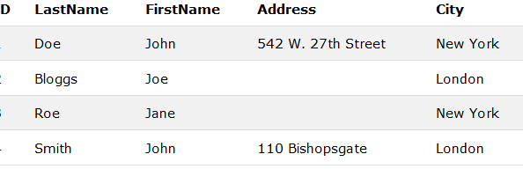
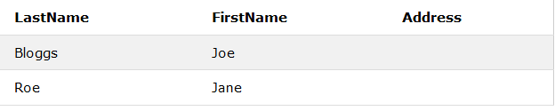
SELECT LastName, FirstName, Address FROM Persons
WHERE Address IS NULL;

Slide 53
SQL UPDATE Statement
The UPDATE statement is used to modify the existing records in a table.
UPDATE Syntax
UPDATE table_name
SET column1 = value1, column2 = value2, ...
WHERE condition;

Slide 54
UPDATE Table
UPDATE Customers
SET ContactName = 'Alfred Schmidt', City= 'Frankfurt'
WHERE CustomerID = 1;

Slide 55
The SQL DELETE Statement
The DELETE statement is used to delete existing records in a table.
DELETE Syntax
DELETE FROM table_name
WHERE condition;

Slide 56
SQL DELETE Example
DELETE FROM Customers
WHERE CustomerName='Alfreds Futterkiste';
DELETE FROM table_name;
DELETE * FROM table_name;

Slide 57
SQL MIN() and MAX() Functions
The MIN() function returns the smallest value of the selected column.
The MAX() function returns the largest value of the selected column.
MIN() Syntax
SELECT MIN(column_name)
FROM table_name
WHERE condition;
MAX() Syntax
SELECT MAX(column_name)
FROM table_name
WHERE condition;

Slide 58
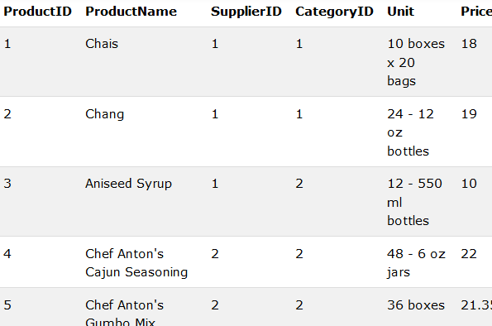
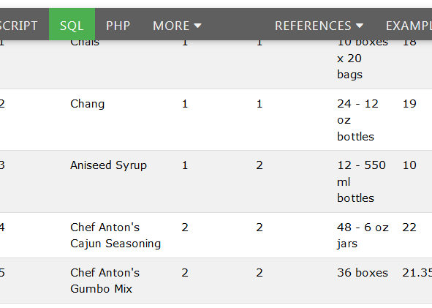
SQL MIN() and MAX() Functions
SELECT MIN(Price) AS SmallestPrice
FROM Products;
SELECT MAX(Price) AS LargestPrice
FROM Products;

Slide 59
SQL COUNT(), AVG() and SUM()
The COUNT() function returns the number of rows that matches a specified criteria.
The AVG() function returns the average value of a numeric column.
The SUM() function returns the total sum of a numeric column.
COUNT() Syntax
SELECT COUNT(column_name)
FROM table_name
WHERE condition;
AVG() Syntax
SELECT AVG(column_name)
FROM table_name
WHERE condition;
SUM() Syntax
SELECT SUM(column_name)
FROM table_name
WHERE condition;

Slide 60
SQL COUNT(), AVG() and SUM()
SELECT COUNT(ProductID)
FROM Products;
SELECT AVG(Price)
FROM Products;
SELECT SUM(Quantity)
FROM OrderDetails;

Slide 61
SQL LIKE Operator
The LIKE operator is used in a WHERE clause to search for a specified pattern in a column.
There are two wildcards used in conjunction with the LIKE operator:
% - The percent sign represents zero, one, or multiple characters
_ - The underscore represents a single character
LIKE Syntax
SELECT column1, column2, ...
FROM table_name
WHERE columnN LIKE pattern;

Slide 62
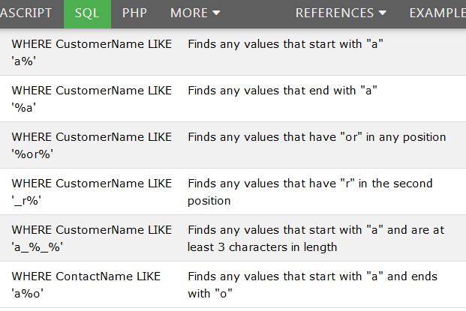
SQL LIKE Operator

Slide 63
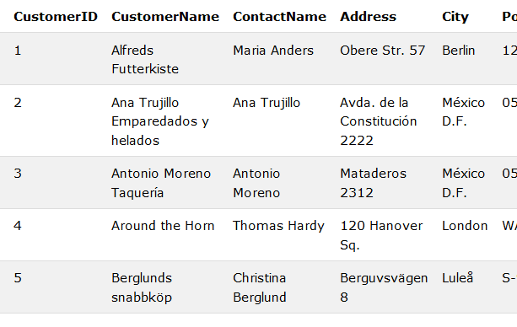
SELECT * FROM Customers
WHERE CustomerName LIKE 'a%';
SELECT * FROM Customers
WHERE CustomerName LIKE '%a';

Slide 64
The SQL IN Operator
The IN operator allows you to specify multiple values in a WHERE clause.
The IN operator is a shorthand for multiple OR conditions.
IN Syntax
SELECT column_name(s)
FROM table_name
WHERE column_name IN (value1, value2, ...);

Slide 65
The SQL IN Operator
SELECT * FROM Customers
WHERE Country IN ('Germany', 'France', 'UK');
SELECT * FROM Customers
WHERE Country NOT IN ('Germany', 'France', 'UK');

Slide 66
The SQL BETWEEN Operator
The BETWEEN operator selects values within a given range. The values can be numbers, text, or dates.
The BETWEEN operator is inclusive: begin and end values are included.
BETWEEN Syntax
SELECT column_name(s)
FROM table_name
WHERE column_name BETWEEN value1 AND value2;

Slide 67
The SQL BETWEEN Operator
SELECT * FROM Products
WHERE Price BETWEEN 10 AND 20;
SELECT * FROM Products
WHERE Price NOT BETWEEN 10 AND 20;

Slide 68
SQL Aliases
SQL Aliases
SQL aliases are used to give a table, or a column in a table, a temporary name.
Aliases are often used to make column names more readable.
An alias only exists for the duration of the query.
Alias Column Syntax
SELECT column_name AS alias_name
FROM table_name;

Slide 69
SQL Aliases
SELECT CustomerID as ID, CustomerName AS Customer
FROM Customers;
SELECT CustomerName AS Customer, ContactName AS [Contact Person]
FROM Customers;

Slide 70
SQL GROUP BY Statement
The SQL GROUP BY Statement
The GROUP BY statement is often used with aggregate functions (COUNT, MAX, MIN, SUM, AVG) to group the result-set by one or more columns.
GROUP BY Syntax
SELECT column_name(s)
FROM table_name
WHERE condition
GROUP BY column_name(s)
ORDER BY column_name(s);

Slide 71
SQL GROUP BY Statement
SELECT COUNT(CustomerID), Country
FROM Customers
GROUP BY Country;
SELECT COUNT(CustomerID), Country
FROM Customers
GROUP BY Country
ORDER BY COUNT(CustomerID) DESC;

Slide 72
SQL HAVING Clause
The SQL HAVING Clause
The HAVING clause was added to SQL because the WHERE keyword could not be used with aggregate functions.
HAVING Syntax
SELECT column_name(s)
FROM table_name
WHERE condition
GROUP BY column_name(s)
HAVING condition
ORDER BY column_name(s);

Slide 73
SQL HAVING Clause
SELECT COUNT(CustomerID), Country
FROM Customers
GROUP BY Country
HAVING COUNT >5
The following SQL statement lists the number of customers in each country, sorted high to low (Only include countries with more than 5 customers):(CustomerID) > 5;

Slide 74
SQL CREATE VIEW Statement
In SQL, a view is a virtual table based on the result-set of an SQL statement.
A view contains rows and columns, just like a real table. The fields in a view are fields from one or more real tables in the database.
CREATE VIEW Syntax
CREATE VIEW view_name AS
SELECT column1, column2, ...
FROM table_name
WHERE condition;

Slide 75
SQL CREATE VIEW Examples
CREATE VIEW [Current Product List] AS
SELECT ProductID, ProductName
FROM Products
WHERE Discontinued = No;

Slide 76
DATA CONTROL LANGUAGE
DCL Commands are used to restrict the operations on a database object for a particular user.DBA GRANTS and REVOKE the user privileges using grant and revoke commands.
Privileges represents the rights to a particular user to access ,manipulate,destroy various objects
Note-A user can be granted all the privileges or some specific privileges

Slide 77
Creating Data Base users
Note-Before a privilege can be granted to user ,it is mandatory to create a user first
How to Create Data Base user
Syntax- Create user username
Identified by password;
Example-Create user abc
Identified by hello;
Output – User created
Note-user abc does not have any privileges at this point,so he cannot do anything with the database right now

Slide 78
Granting and Revoke Command
Privilages can be either system or object privilages
Object Privilages-
Object Privileges | Description
INSERT | allows users to insert rows into a table.
SELECT | allows users to select data from a database object.
UPDATE | allows user to update data in a table.
ALTER | .Allows the user to change the table defination
DELETE | Allows the user to delete the record
Index | Allows the user to create index
With Grant option | Allows the user to grant privileges to some other users

